Slide 1
Welcome to ACP Institute

Slide 2
ACP Institute has proudly placed 500+ Students in top companies!

Slide 3
Our Student’s Success Stories
ACP Institute has helped its students build successful careers across various fields.

Slide 4

PALAK KHURANA
Job Role: Sr. SharePoint Developer
Company: Wipro Technologies Ltd.
Location: Pune
Package: 5.5 LPA
Course : C Language

Slide 5

SAKSHI
Job Role : Cybersecurity Specialist
Company : HCL
Location : Gurugram
Package : 7 LPA
Course : C Language, Networking

Slide 6

SANJAY PANCHAL
Job Role: Data Scientist
Company: USA-based Company
Location: Gurugram
Package: 15 LPA
Course : Python, Excel, PowerBi

Slide 7

ANKIT
Job Role : Aml Analyst
Company : Genpact
Location: Gurugram
Package: 15 LPA
Course : Java, C++

Slide 8
MANOJ GABA
Job Role: Application Developer (iOS)
Company:
Location: Gurugram
Package: 12 LPA
Technology:
Project: Gohana Mudrika (Mobile Application)

Slide 9
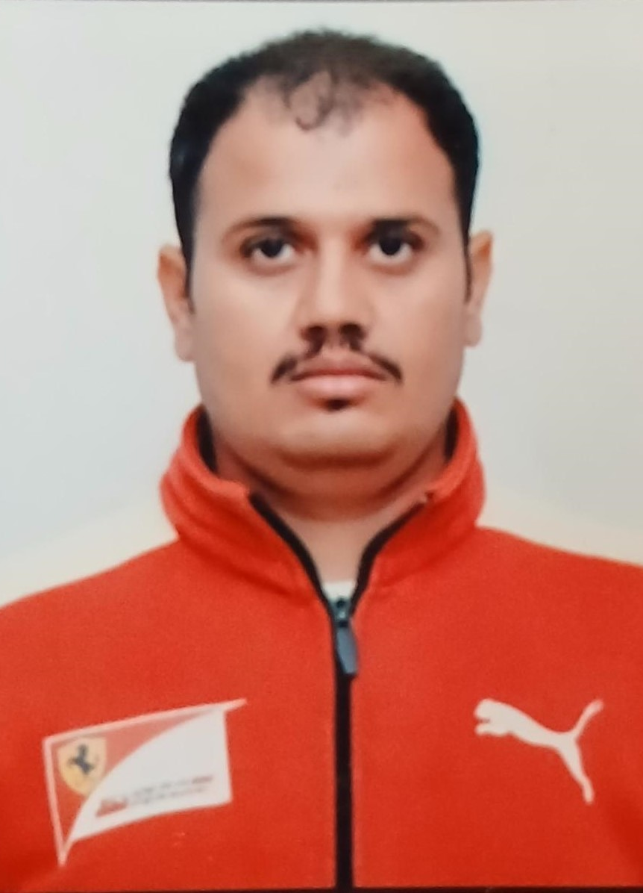
AASHISH MALIK
Job Role: Cashier
Company: Loves Pvt. Ltd.
Country : America State : Louisiana
Course : IELTS
Package: 36 LPA

Slide 10
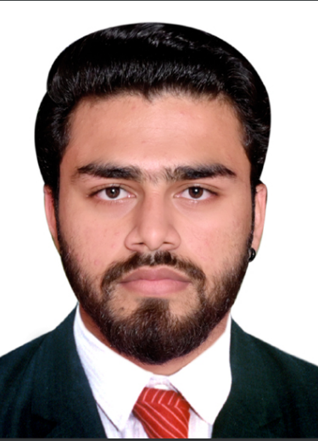
ABHISHEK
Job Role: Jr. Clerk
Company: Wolt
Country : Europe, Georgia
Course : IELTS, BASIC COMPUTER, TALLY
Package: 30 LPA

Slide 11

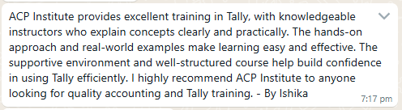
ISHIKA
Job Role: Associate in Audit
Company: EY GDS
Location : Noida
Course : TALLY, GST
Package: 5 LPA

Slide 12
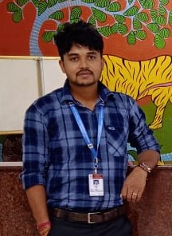
SUMIT
Job Role: DEO
Department : Ministry of Defence
Location: PUNE
Package: 5.5 LPA
Course: Typing, Word, Excel

Slide 13

DEEPAK
Job Role: Sorting Assistant
Department : Airport Indian Post
Location: Delhi
Package: 6 LPA
Course: Typing, Word, Excel

Slide 14

RAVI
Job Role: GD
Location: Delhi
Package: 5.4 LPA
Course: Hindi and English Typing

Slide 15
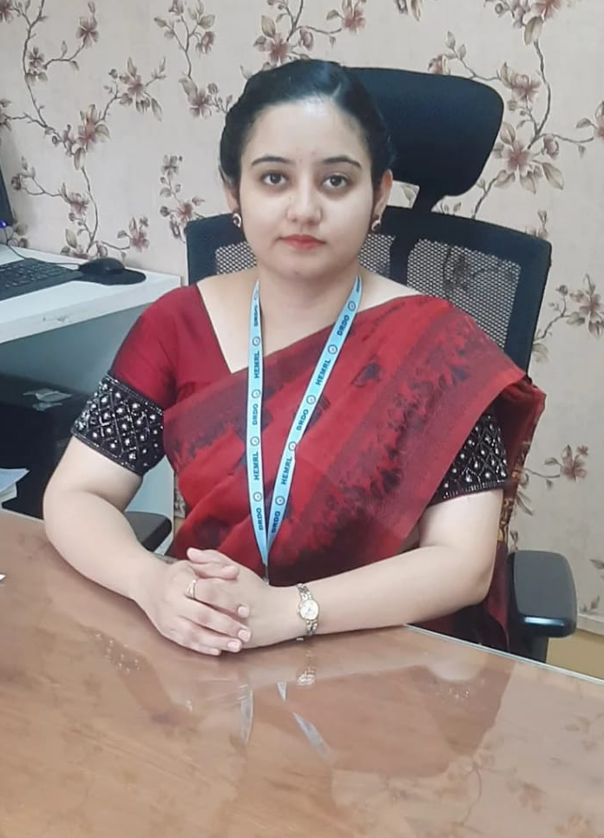
ANJU
Job Role: Senior Technical Assistant
Department : Ministry of Defence
Location: Pune
Package: 10 LPA
Course: Typing English, Basic Computer

Slide 16

ANJU MALIK
Job Role: Constable Level 3rd
Department : Delhi police
Location: Delhi
Package: 4.5 LPA
Course: Typing English, Basic Computer

Slide 17

SACHIN
Job Role: ACCOUNTANT
Company : SHRI BALAJI PHARMA
Location: GOHANA
Package: 2 LPA
Course : Tally, Typing, Excel

Slide 18
KHUSHI
Job Role: Assistant
Department : National Bureau of Plant Genetic
Location: Delhi
Package: 10 LPA
Course : Typing , Basic Computer
Disability :

Slide 19
LIST OF COURSES
Basic Computer
Graphics Designing
Photoshop
Illustrator
CorelDraw
Typing (Eng/Hin)
Steno (Eng/Hin)
Account / Tally Prime
Busy Software
Python
Advance Excel
Data Science
Data Analyst
Java Development
Web Development
Software Development
English Spoken
IELTS
PTE
NTT
YOGA
FIRE & SAFETY
Digital Marketing
Google Ads
Meta Ads
SEO

Slide 20
Students Projects

Slide 21
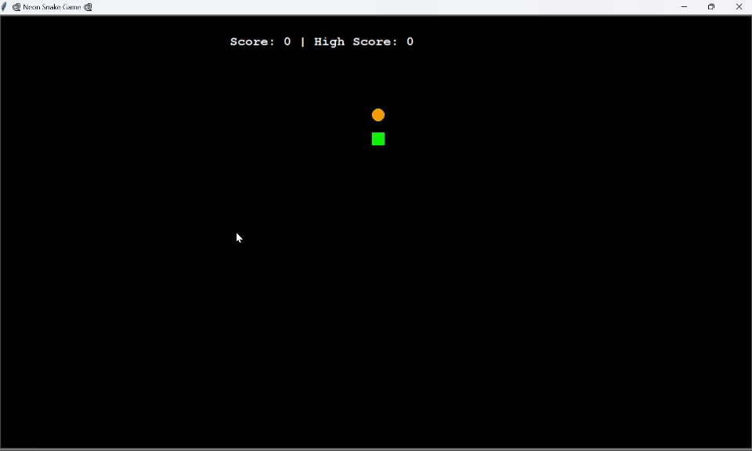
Snake Game

Slide 22
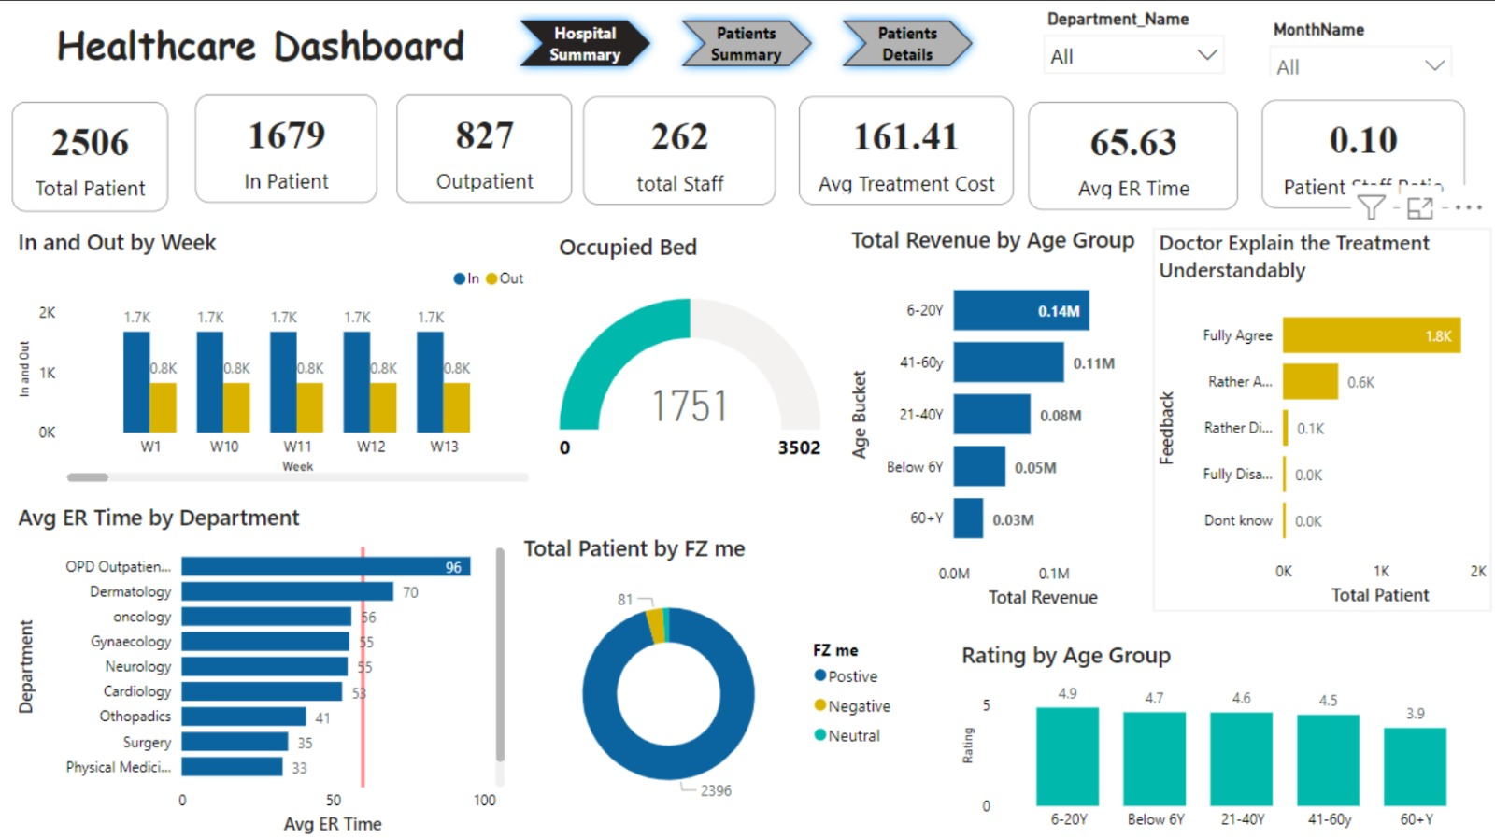
PowerBI Dashboard

Slide 23
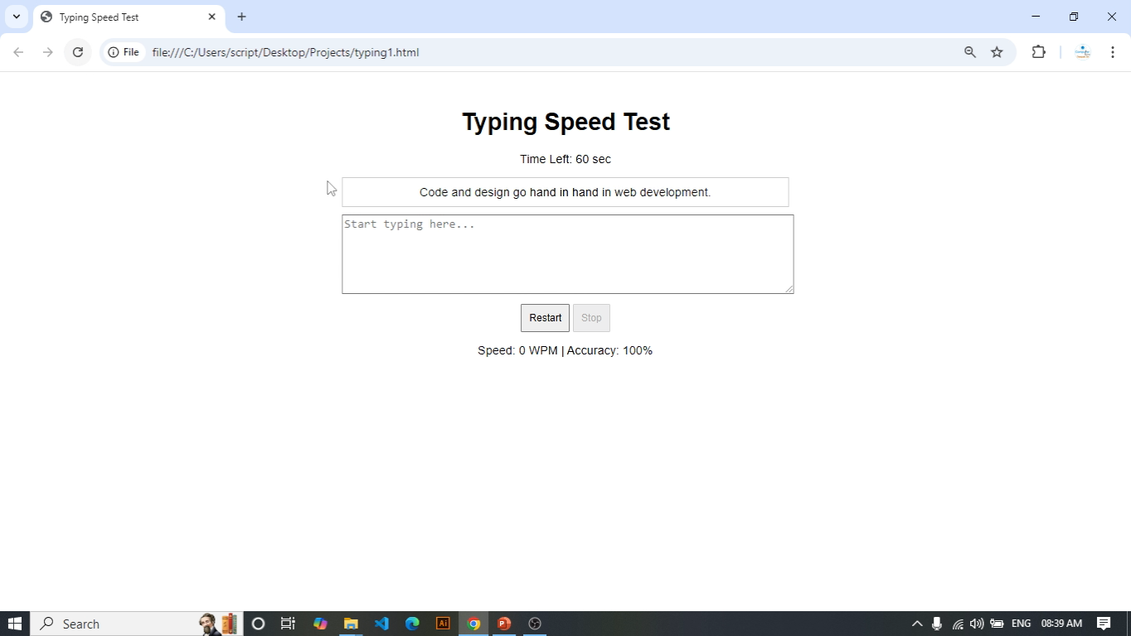
Typing Speed Test

Slide 24
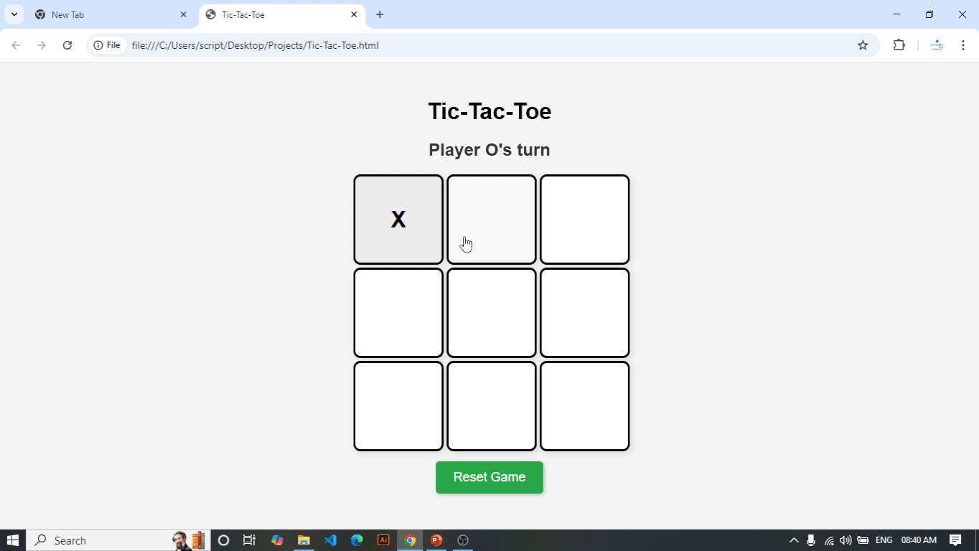
Tic-Tac-Toe Game

Slide 25
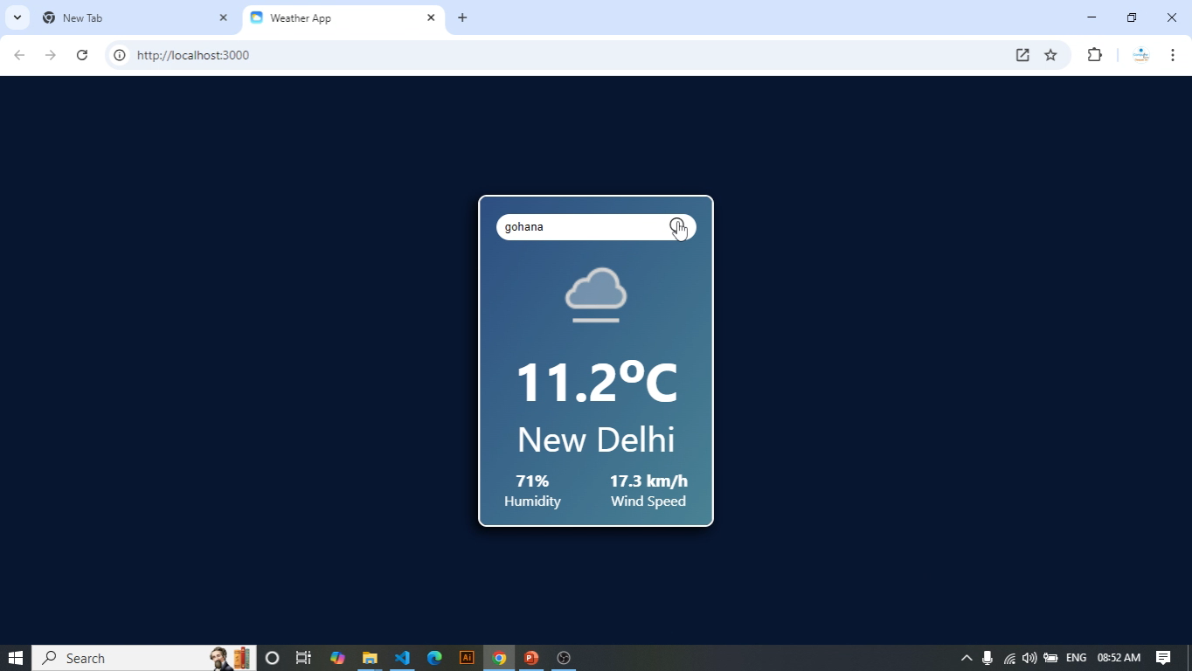
Weather App

Slide 26
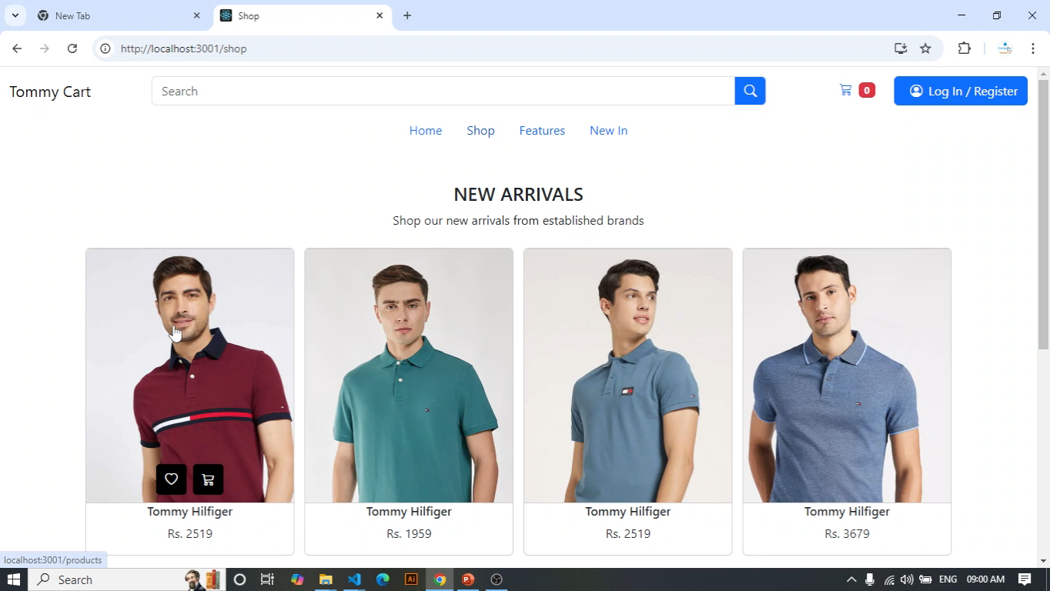
Ecommerce Web

Slide 27
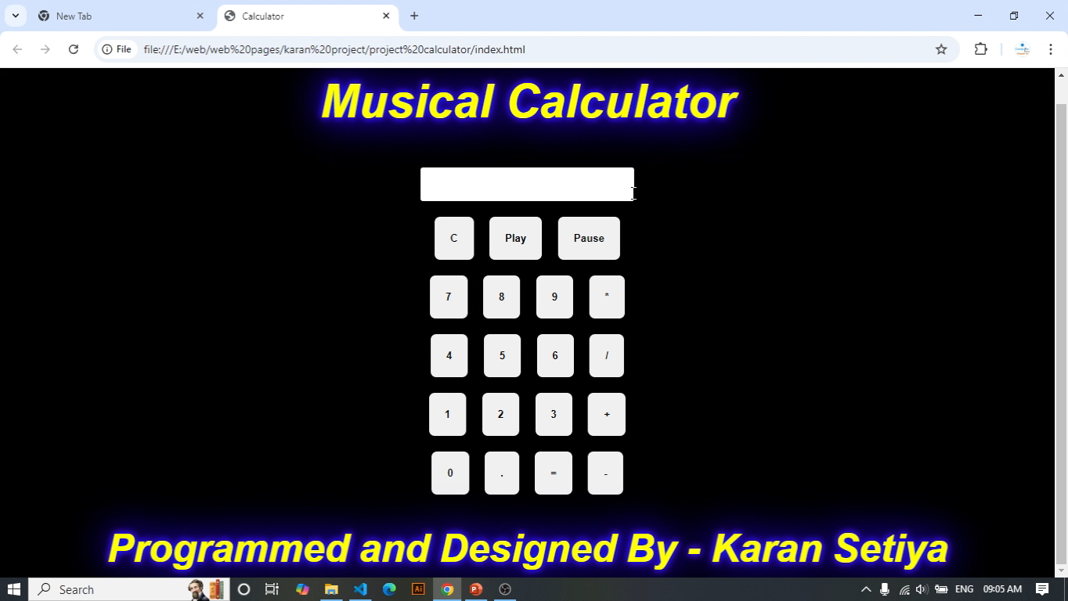
Music Calculator

Slide 28
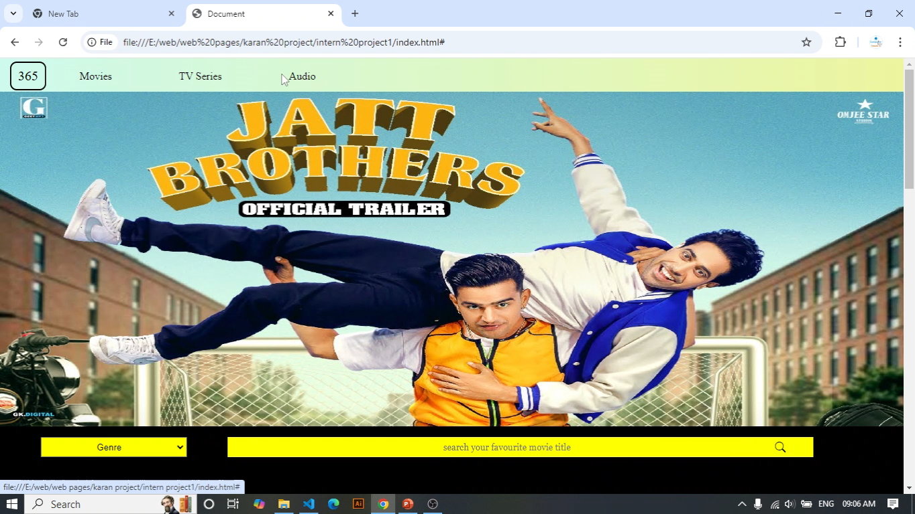
Movie Website Designed By Karan

Slide 29
Meet Our Team

Slide 30
MR. NAVEEN
Specialization
JAVA (MOBILE APPLICATION)
C LANGUAGE (CHIP SOFTWARE)
C++ (GAME DEVELOPMENT)
Experience
12 year

Slide 31
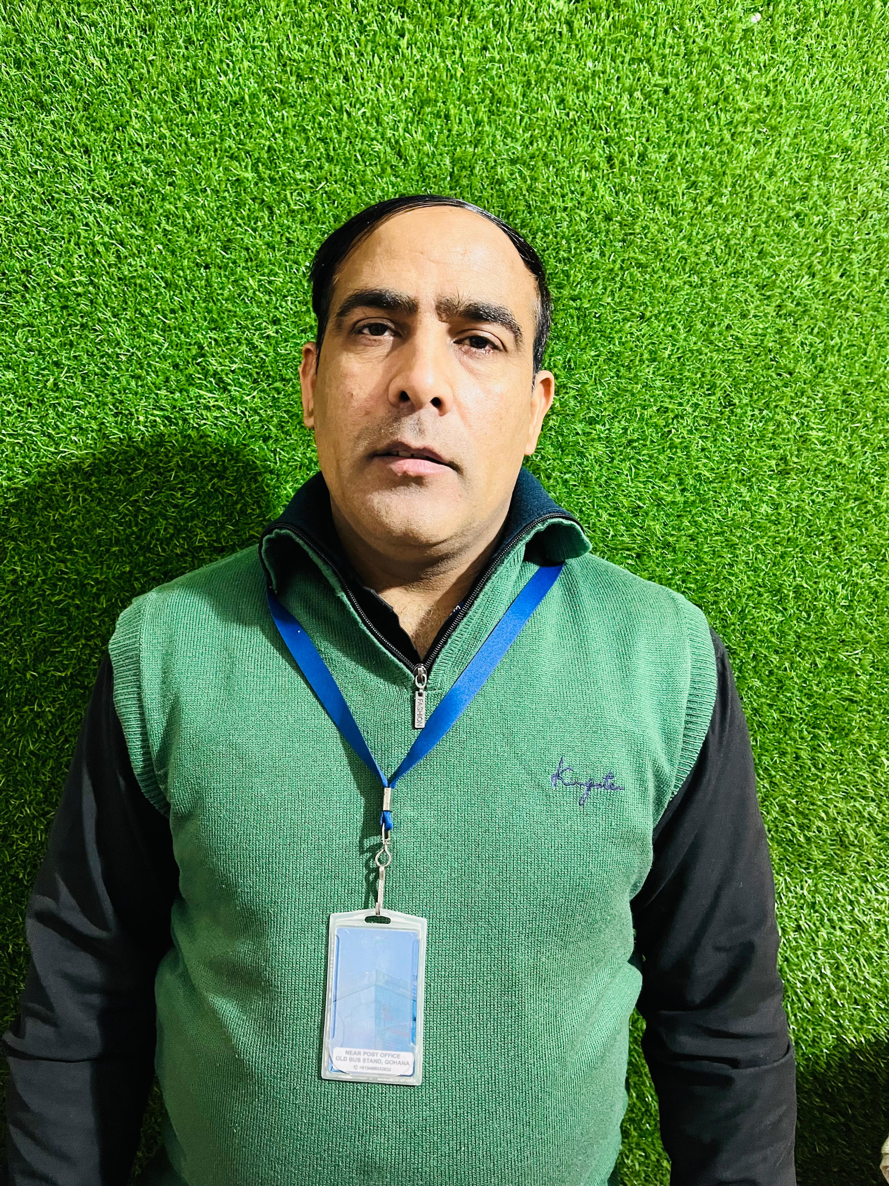
MR. SATISH DAGAR
Specialization
ACCOUNT
TALLY
BUSY
GST
BASIC COMPUTER
Experience
25 year

Slide 32
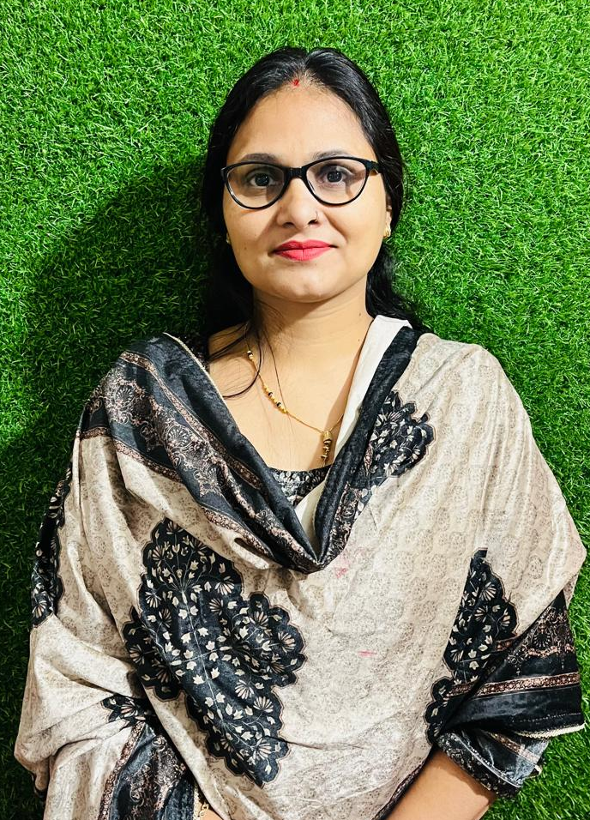
MS. MEENU
Specialization
Typing Expert
Steno Expert
Experience
5 Year

Slide 33
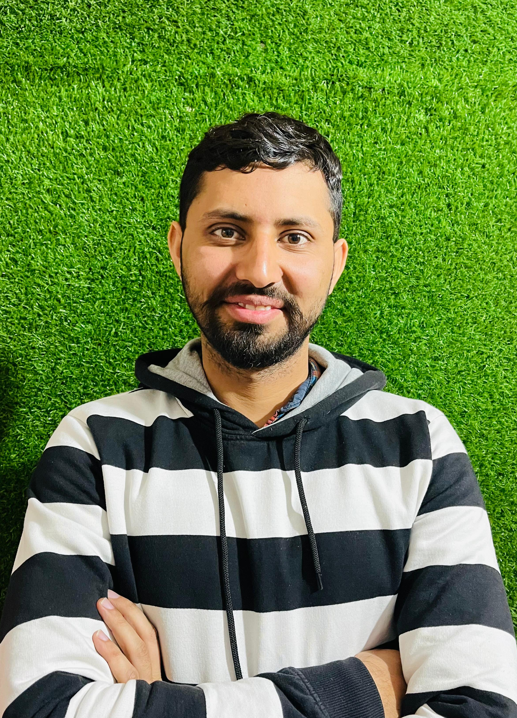
MR. BHUPENDER
Specialization
Data Science
Data Analyst
Python
AI
Experience
2 Year

Slide 34
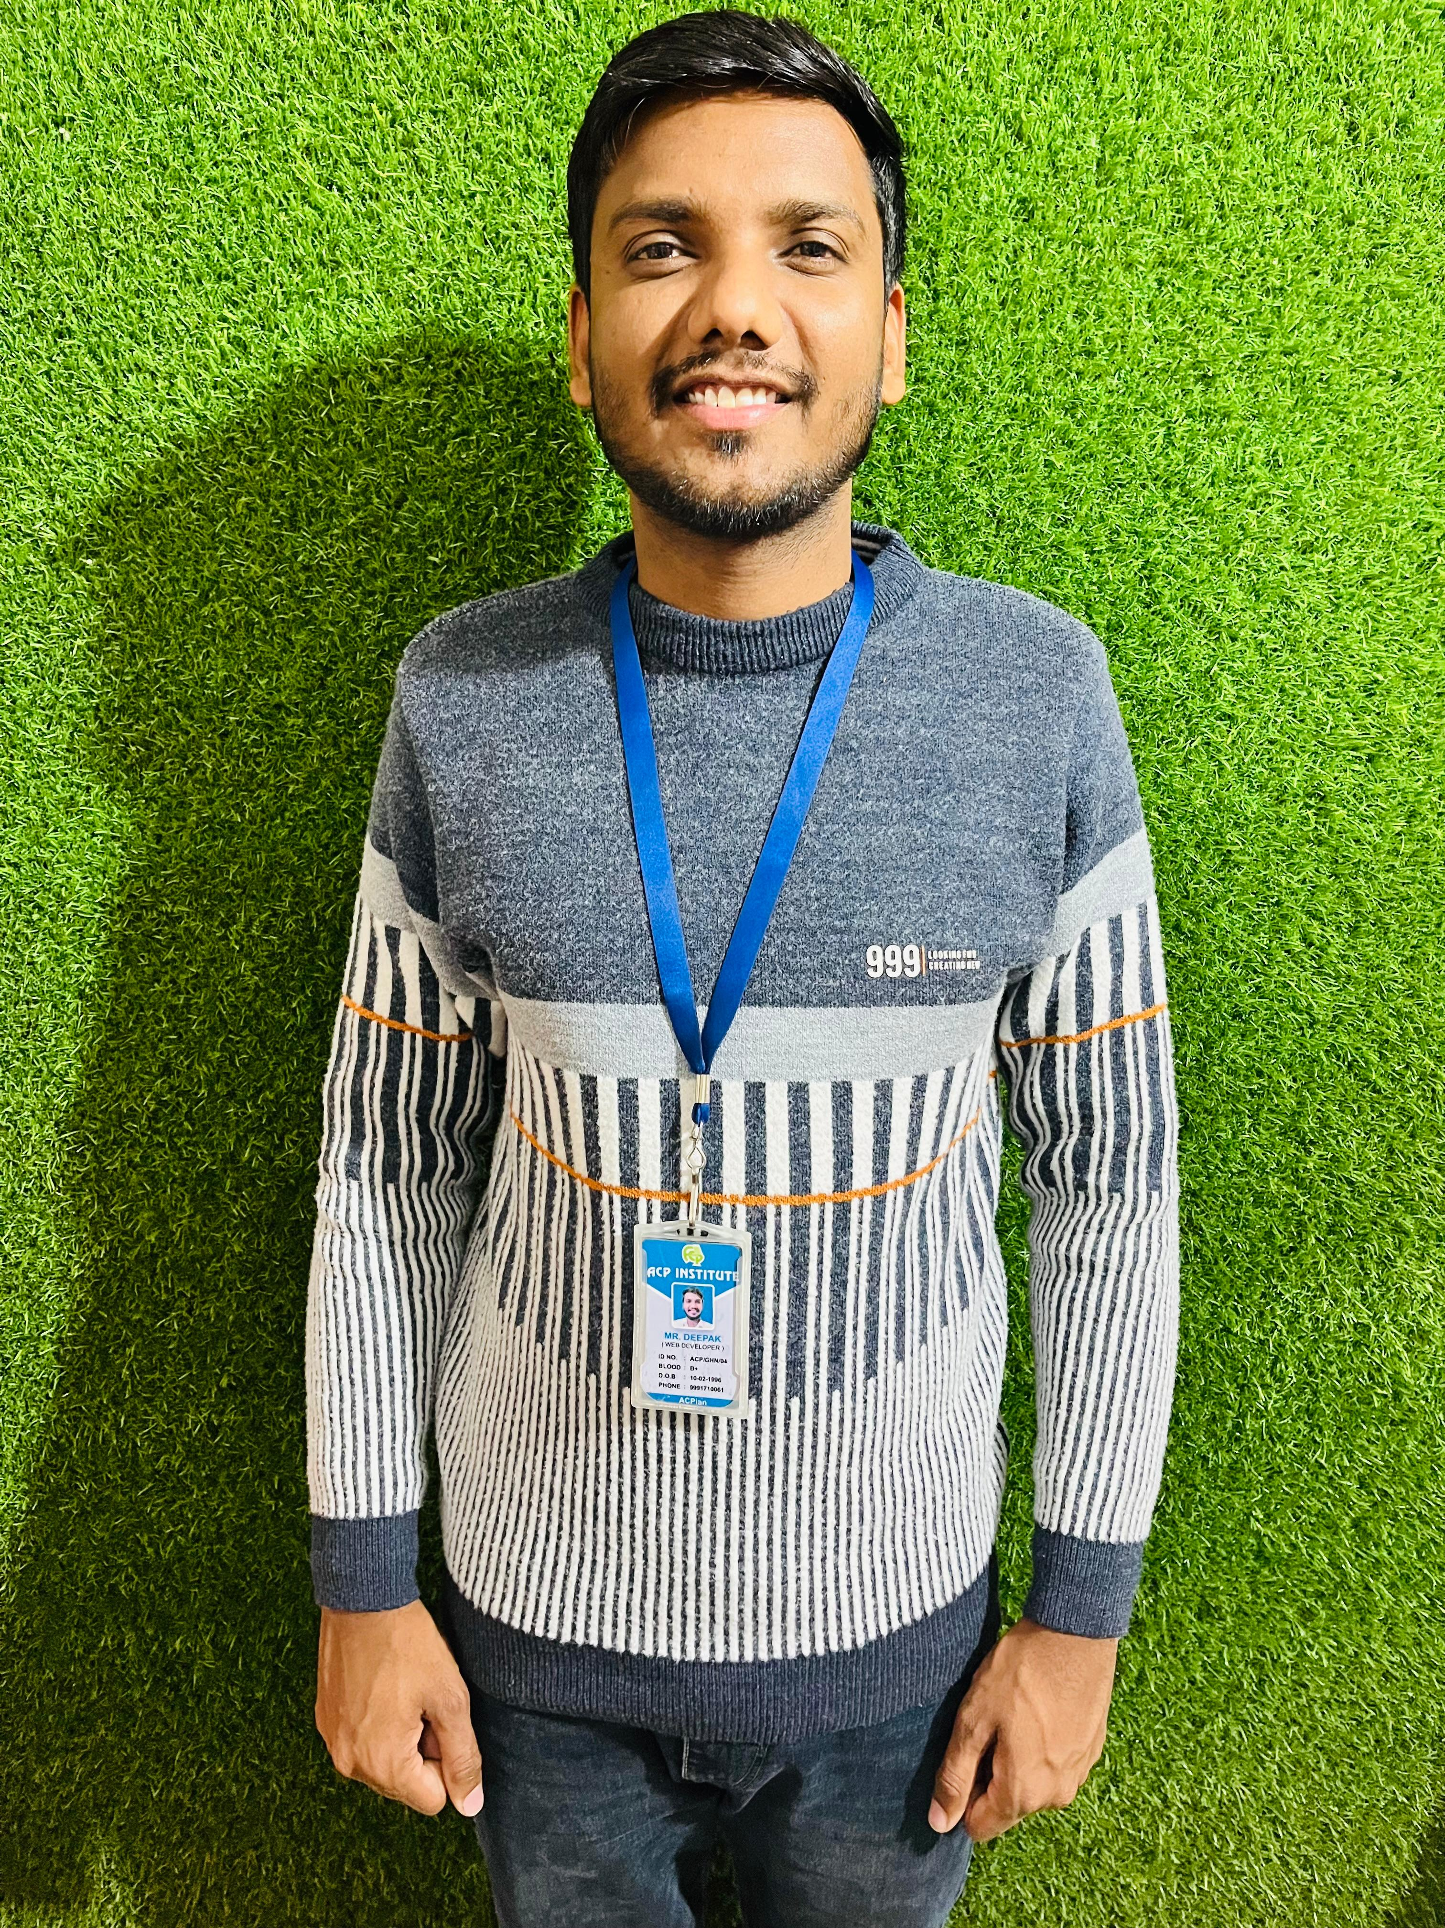
MR. DEEPAK
Specialization
Web Development (Full Stack)
Graphics Designing
Basic Computer
Advance Excel
Experience
7 Year

Slide 35
THANK YOU

